Slide 1
MATH4994 Capstone Project Bounded, Discrete, Fair Allocation Procedure for 4 Players
Au Yik Hau (20762422)
Cheung Tsz Hin (20437247)

Slide 2
Table of contents
01
02
03
04
Introduction
3-person protocol
Background
Motivation
Domination & Premutation
Core idea to n-person fair allocation
4-person protocol
Conclusion
Post Double Domination Protocol
Core Protocol
Premutation Protocol
Overall Protocol
Major Founding
Strategy-Proof demonstration
Envy-freeness & Boundness

Slide 3
01
Introduction

Slide 4
Introduction
Background:
The cake cutting algorithm is a metaphor for resources allocation, we aim to find an fair algorithm that can achieve fair allocation, which can satify pareto optimal, envy-free.
Motivation:
Since an envy-free allocation is guaranteed to exist up to n-1 cuts¹, we will present a discrete, envy-free alogorithm protocol for 3 and 4 players with bounded number of queries as well as cuts of the cake.

Slide 5
02
3 Players protocol

Slide 6




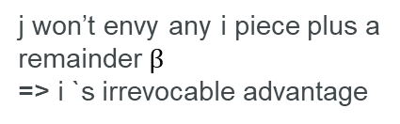
3 Players protocol – Methodology
Domination
Ordinal
j give a weak ordering over pieces but can’t tell exact cardinal utility difference between them
=> indifference between pieces

Slide 7
This protocol will have a total of 4 stages:
Stage 0: Player 3 equally trim 3 pieces
Stage 1: Player 1 & 2 trim their most preferred piece
Stage 2: Player 1 & 2 trim their most preferred reminder
Stage 3: Player 1 & 2 exchange their holding

Slide 8
Stage 0:
Player 3 trim the cake into 3 equal piece base on his valuation

Slide 9
Stage 1:
Player 1 & 2 place a knife on their most preferred piece so that the cake they choose will have a trimmed piece equal to their second most preferred piece and a remainder β₁

Slide 10
Stage 1:
1₁
2₁
3₁
Case 1 (M0):
If 1 and 2 have a different complete most-preferred piece
=> assign the cake to them accordingly
=> assign the remaining complete piece to player 3
=> end

Slide 11
-i
i
Stage 1:
Case 2 (M1):
Else, they will trim the same cake
=> we denote the player with the leftmost trim as (-i), other as (i)
=> the cake will be trimmed by the leftmost knife

Slide 12
-i
Stage 1:
β₁
i₁
-i₁
3₁
Case 2 (M1) (cont’):
The second most preferred piece by (-i) -> (-i)
The trimmed piece -> (i)
The remaining complete piece -> 3
The remainder β₁ -> will be further trim and allocated in next stage

Slide 13
-i
Stage 2:
β₁
i₁
-i₁
3₁
Consider β₁
β₁

Slide 14
-i
β₁
i₁
-i₁
3₁
Consider β₁
β₁

Slide 15
Stage 2:
Player 3 trim the remainder β₁ into 3 equal piece base on his valuation

Slide 16
Stage 2:
Player 1 & 2 place a knife on their most preferred piece so that the cake they choose will have a trimmed piece equal to their second most preferred piece and a remainder β₂

Slide 17
Stage 2:
1₂
2₂
3₂
Case 1 (M0):
If 1 and 2 have a different complete most-preferred piece
=> assign the cake to them accordingly
=> assign the remaining complete piece to player 3
=> end

Slide 18
-i/i
-i/i
Stage 2:
Case 2 (M1):
Else, they will trim the same cake
=> the cake will be trimmed by the leftmost knife

Slide 19
-i/i
Stage 2:
β₂
(i/-i)₂
(-i/i)₂
3₂

Slide 20
i
Stage 3:
β₂
-i₂
i₂
3₂
Case 1:
If the leftmost trim is (i) this time, not (-i)
The second most preferred piece by (-i) -> (-i)
The trimmed piece -> (i)
The remaining complete piece -> 3
The remainder β₂ -> cut & choose between (i) & (-i)
=> end

Slide 21
-i
Stage 3:
β₂
i₂
-i₂
3₂
Case 2:
If the leftmost trim is (-i) again
The second most preferred piece by (i) -> player (i)
The trimmed piece -> player (-i)
The remaining complete piece -> player (3)

Slide 22
-i
i
Stage 3:
β₂
γ₂
i’₂
-i₂
3₂
We define the cake between (i) and (-i) in stage 2 as γ₂

Slide 23
-i
i
Stage 3:
β₁
γ₁
i’₁
-i₁
3₁
Similarly, we define the cake between (i) and (-i) in stage 1 as γ₁

Slide 24
-i
i
Stage 3:
β₁
γ₁
i’₁
-i₁
3₁
β₂
γ₂
i’₂
-i₂
3₂
Player (i) pick less preferred γ_{j} between {γ₁ , γ₂}, j = 1,2,
Then exchange (i’)_{j} with (-i)_{j}
The remainder β₂ -> cut & choose between (i) & (-i)
=> end

Slide 25
Overall
β₁
i₁
-i₁
3₁
Stage 1
β₂
-i₂
i₂
3₂
Stage 2
(i/-i)₃
(-i/i)₃
If β exist

Slide 26
Key Takeaway
Notes - 1
We use Domination and ordinal to achieve envy-freeness
e.g.
(3) always get the complete piece
=> player (3) dominate (1), ordinal between cake 2&3,
=> so (3) will be envy-free

Slide 27
Key Takeaway
Notes - 2
We use Partial cut and permutation to achieve envy-freeness
e.g.
Consider cut at {1,2 | | } , cut at 1 then give this trimmed piece to (2), will mean there’s bonus to (2), indifferent for (1), dominated by (3)

Slide 28
03
4 Players protocol

Slide 29
4 Players protocol – Setup
Post Double Domination Protocol
Core Protocol
Permutation Protocol
Overall Protocol

Slide 30
3.1
Post Double Domination Protocol

Slide 31
This protocol is like a function, will be served as a key building block for the overall protocol
Input:
A partial envy-free allocation and unallocated cake β
Each agent dominates 2 other agent
Output:
Envy-free complete allocation

Slide 32
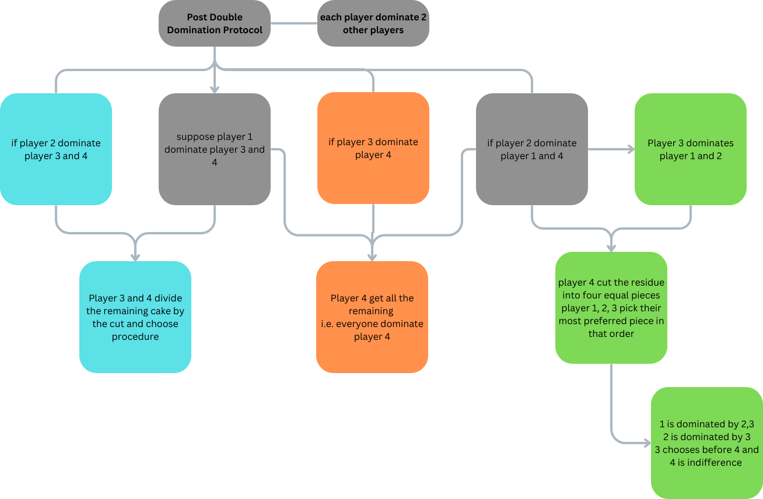
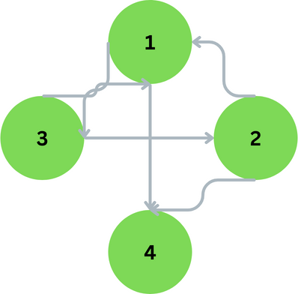
Player domination relationship

Slide 33
3.2
Core Protocol

Slide 34
The Core Protocol assign a cutter who will receive a complete piece and other may get partial pieces. The protocol is to apply on the unallocated piece recursively so that cutter dominates two agents.
Input:
Cutter (says player 4)
Step:
(4) cut the cake into 4 equal piece
(1),(2),(3) place a knife on their most and second most valuable piece respectively to match the value of their third valuable piece
Output:
Partial envy-free allocation (Two complete piece)
(Possibly) unallocated piece

Slide 35
Player 4 trim the cake into 4 equal piece base on his valuation
Stage 0

Slide 36
Player 1,2,3 place a knife on their most preferred and second preferred piece to match the value of their third most valuable piece
Stage 1

Slide 37
Case 1
i₁
j₁
j₂
k₁
i₂
k₂
3 pieces received 2 knife respectively
Suppose, WLOG, denote as i₁j₁ | j₂k₁ | i₂k₂ , {1,2,3} = {i,j,k}

Slide 38
Case 2
i₁
j₁
k₁
i₂
j₂
k₂
2 pieces received 3 knife respectively
Suppose, WLOG, denote as i₁j₁k₁ | i₂j₂k₂

Slide 39
Case 3
i₁
i₂
j₁
k₁
j₂
k₂
3 pieces received 1 knife, 3 knife, 2 knife respectively
Suppose, WLOG, denote as i₁ | i₂ j₁k₁ | j₂k₂

Slide 40
Case 4
i₁
j₁
j₂
k₁
i₂
k₂
4 pieces received 1 knife, 1 knife, 2 knife, 2 knife respectively
Suppose, WLOG, denote as i₁ | j₁ | j₂k₁ | i₂k₂

Slide 41
Case 5
i₁
j₁
k₁
i₂
j₂
k₂
4 pieces received 1 knife, 1 knife, 1 knife, 3 knife respectively
Suppose, WLOG, denote as i₁ | j₁ | k₁ | i₂ j₂k₂

Slide 42
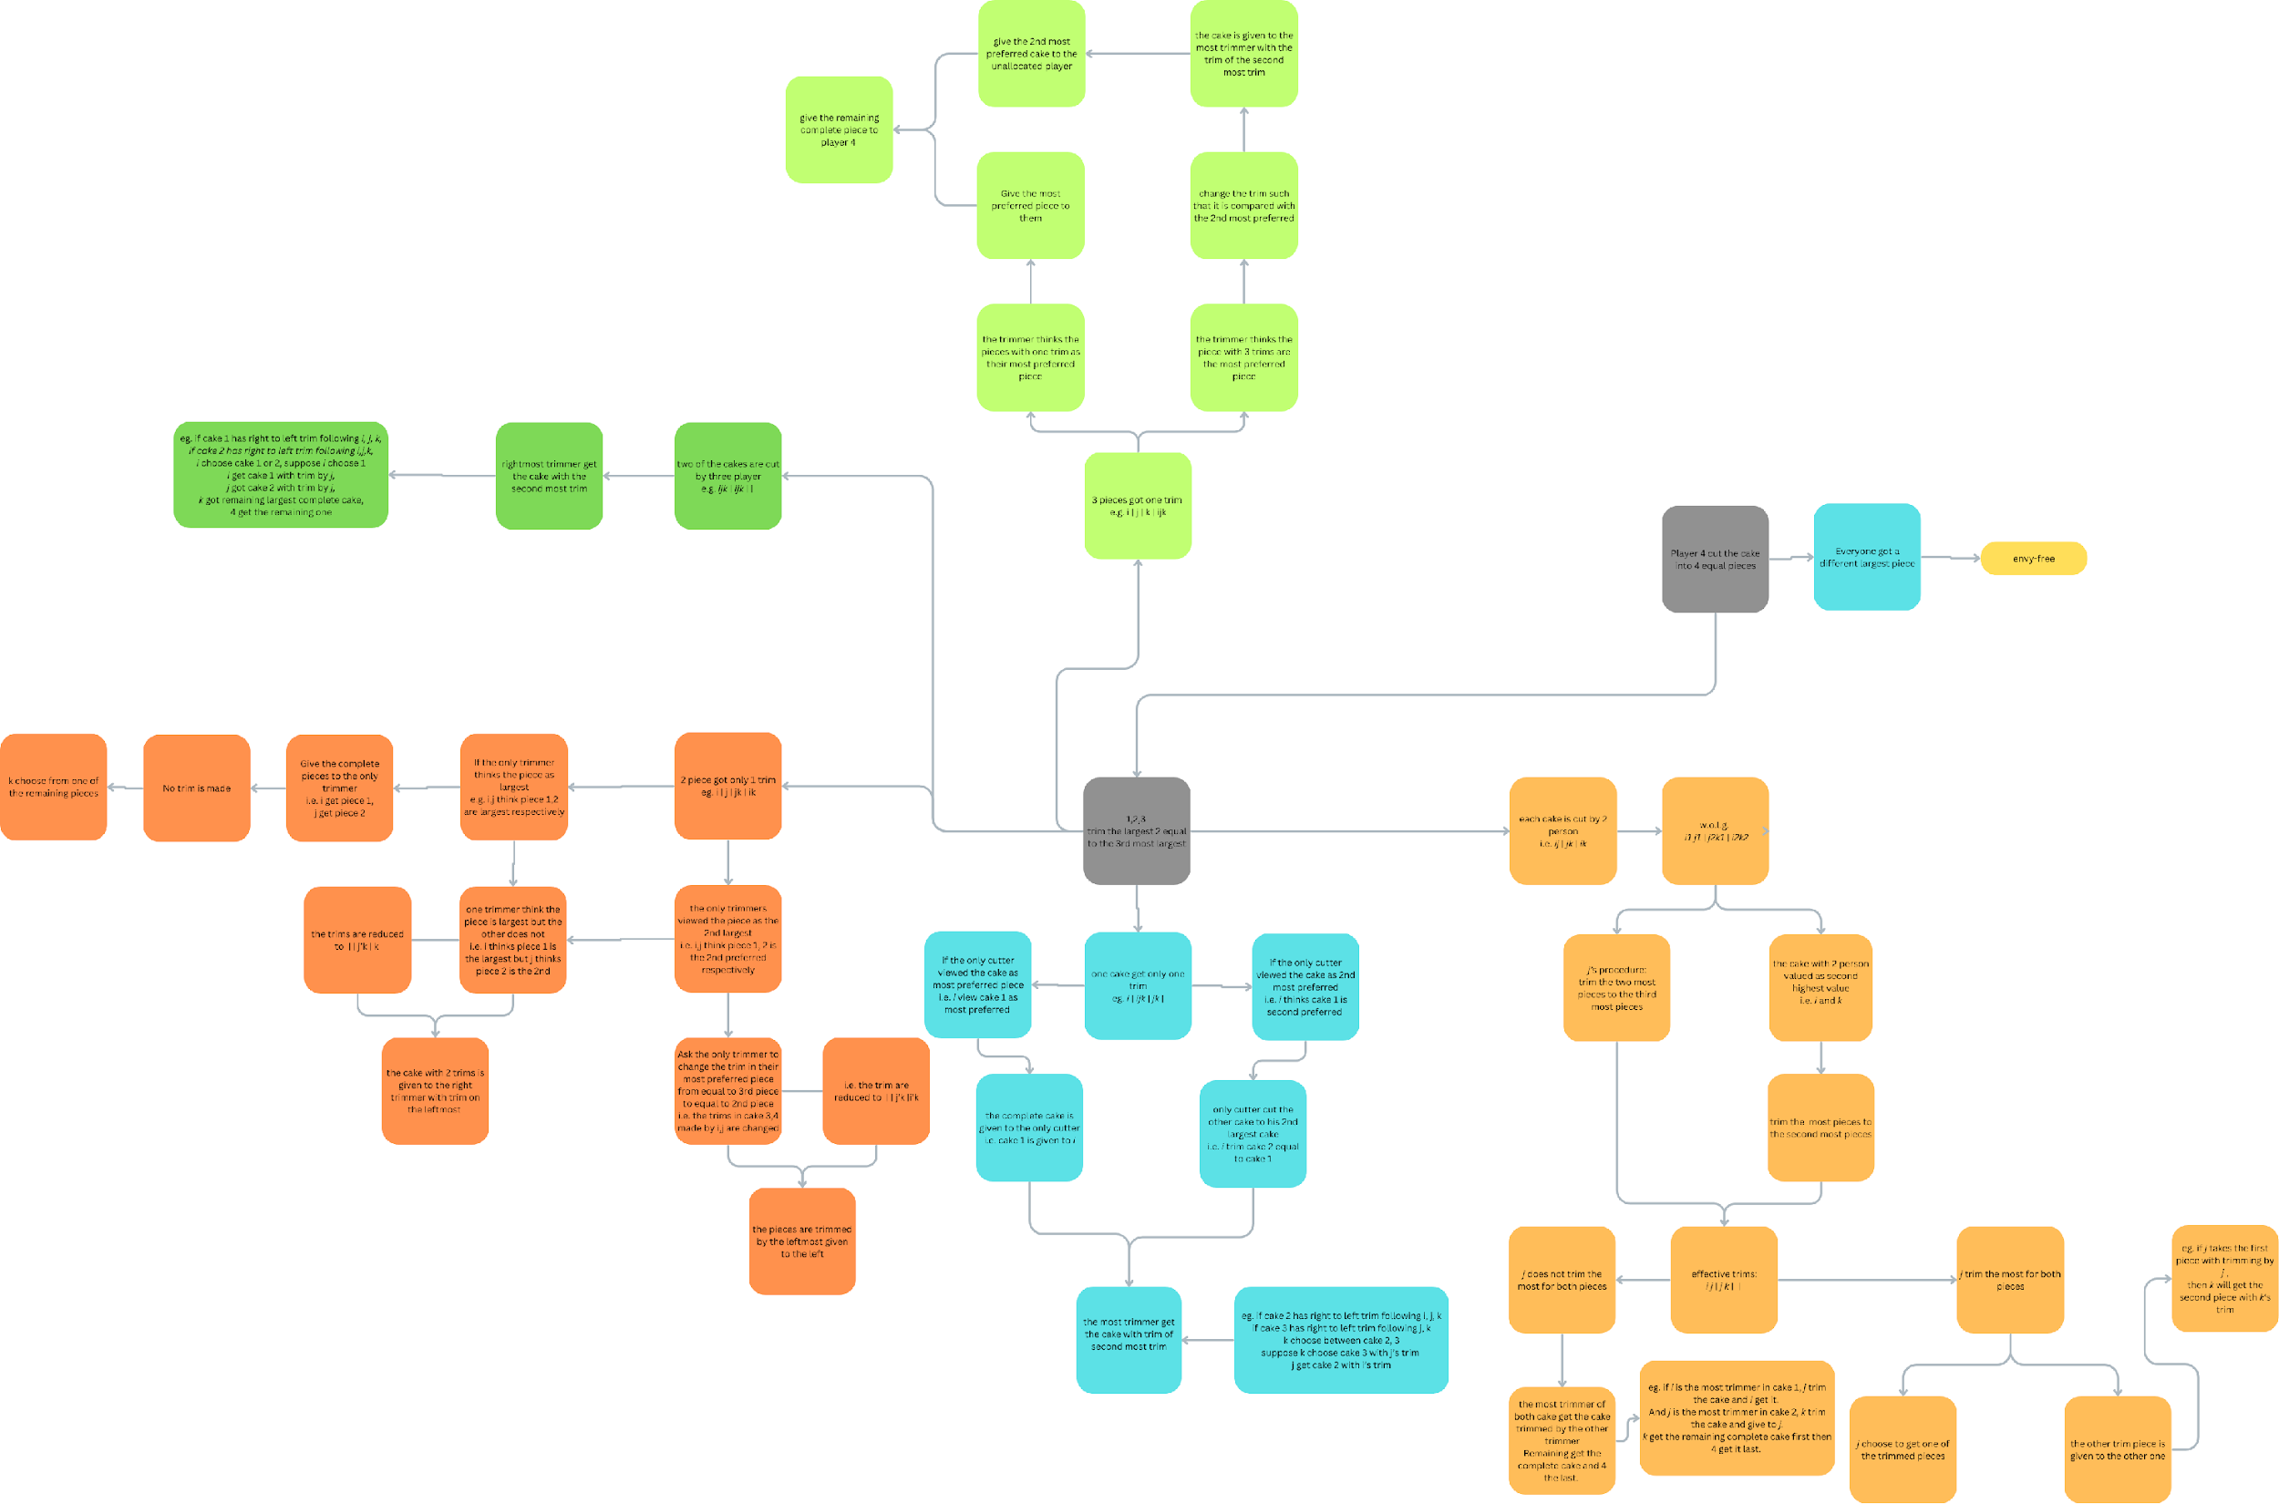
Algorithm flowchart
Algorithm - Permutation Protocol

Slide 43
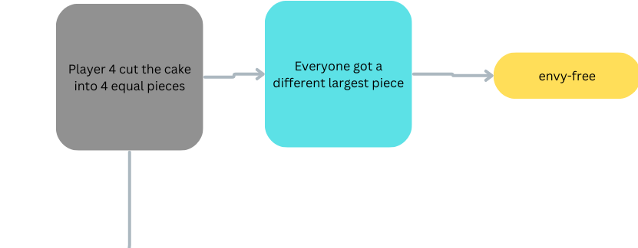
Algorithm - Core Protocol
Player 4 cut the cake into 4 equal pieces according to his valuation
Player 1,2,3 value those piece
If they have a different complete most-preferred piece then
assign the cake to them accordingly
assign the remaining complete piece to player 4
return envy-free allocation
End if
Player 1,2,3 will trim the left hand side of their most and second most valuable piece equally valuable to their third most preferred piece

Slide 44
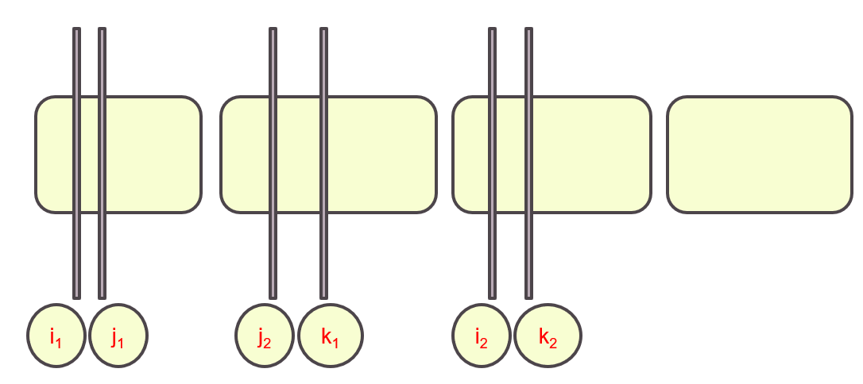
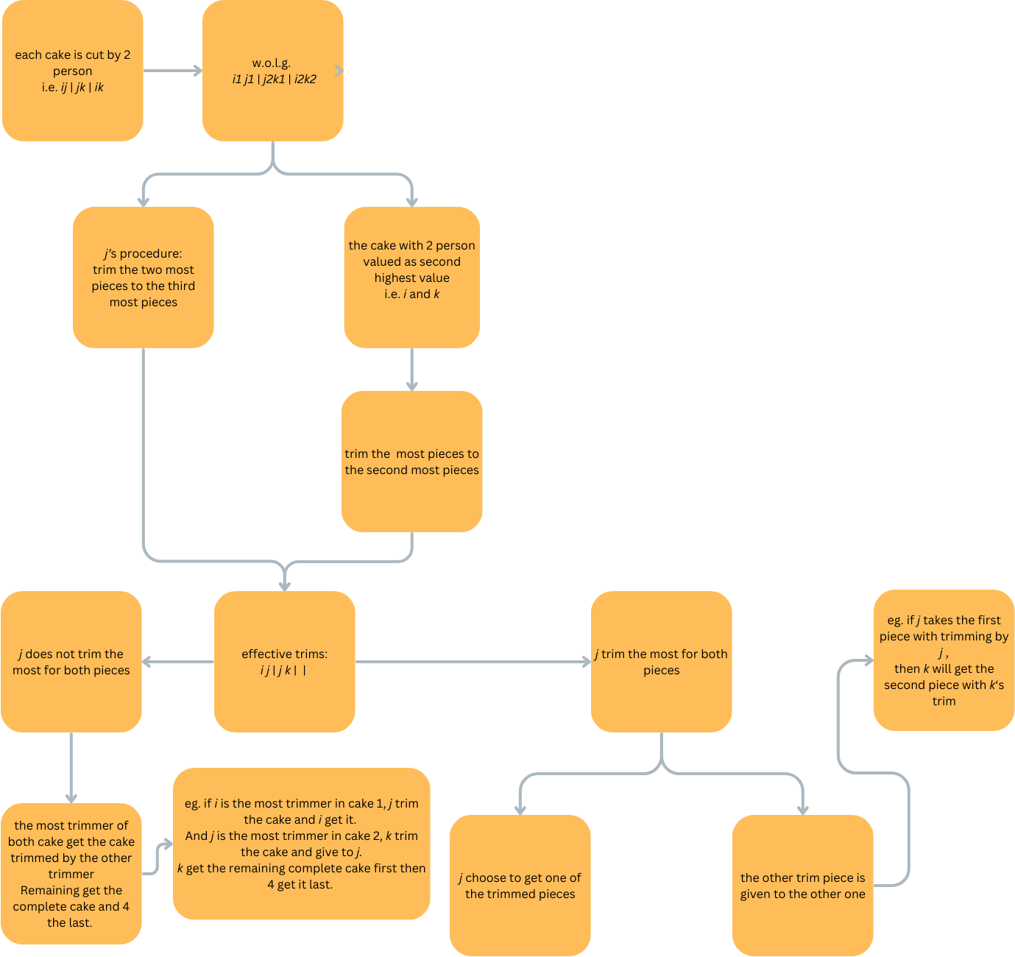
Algorithm - Core Protocol 1
If we are in case 1 (2 trim for 3 piece) i.e. i₁j₁ | j₂k₁ | i₂k₂ then
i & k put new trim on their most preferred piece which equal their second most valued piece; j same trim (effective trim: i j | j k | | |)
If j does not trim the most for both piece then
(consider i₁ j₁ | j₂ k₁ | | |)
rightest trimmer receive the cake trimmed up to 2nd
rightest trim
remaining out of {i,j,k} choose one complete cake
(4) take remaining complete
else if j trim the most for both piece then
(consider i₁ j₁ | k₁ j₂ | | |)
j pick one of the trimmed cake that i or k trimmed
i or k who trim the other cake receive the trimmed
i or k who didn’t trim the other cake pick a complete
cake and (4) pick the remaining complete
End if

Slide 45
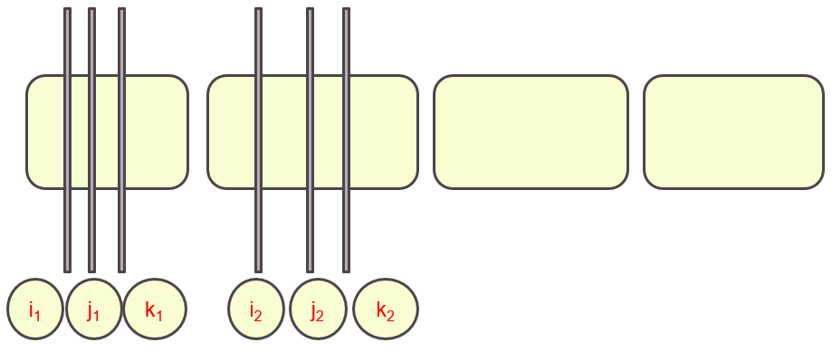
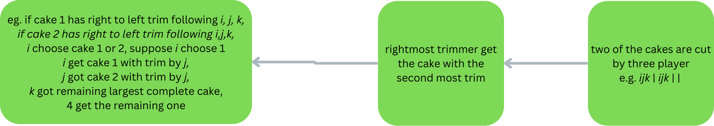
Algorithm - Core Protocol 2
If we are in case 2 (3 trim for 2 piece) i.e. i₁j₁k₁ | i₂j₂k₂ then
the cake will be trimmed in the 2nd knife position and rightmost player will receive it
player who didn’t receive trimmed cake will pick a complete piece
(4) take remaining complete
End if

Slide 46
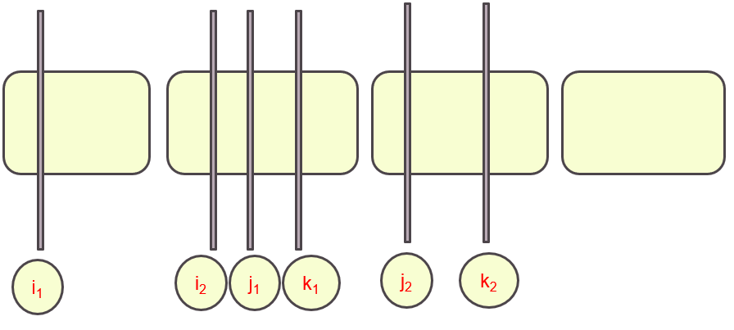
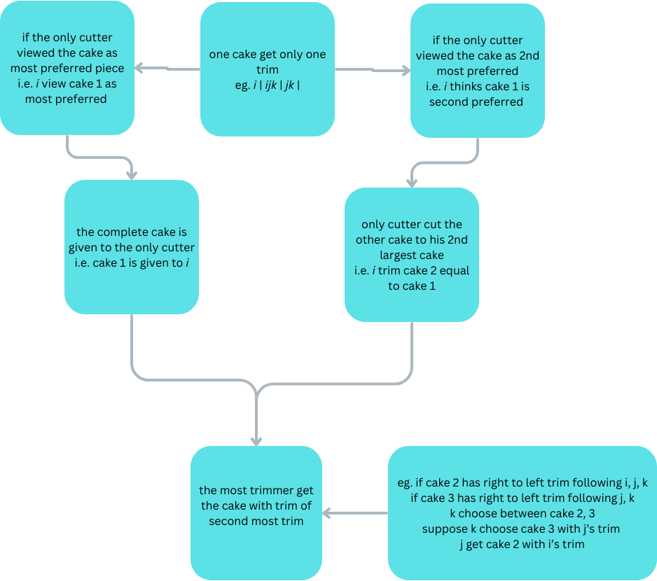
Algorithm - Core Protocol 3
If we are in case 3 (1,3,2 trims for 3 piece) i.e. i₁ | i₂ j₁k₁ | j₂k₂ then
If the solo cutter (i) consider the cake as most preferred piece then
(i) will receive the complete version of this piece
rightmost trim player receive the trimmed cake up
to second rightmost trim
else ((i) view it as second most preferred, says cake1)
(i) cut cake 1 so it equally valuable to his trim in
cake 2
rightmost trim player receive the trimmed cake up
to second rightmost trim
End if

Slide 47
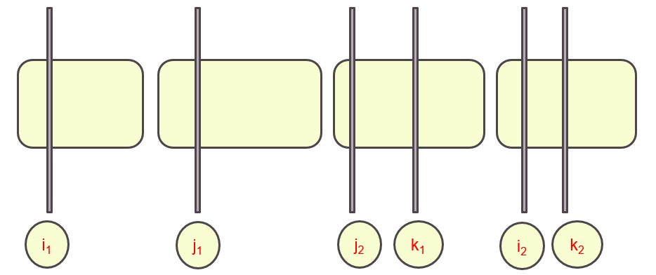
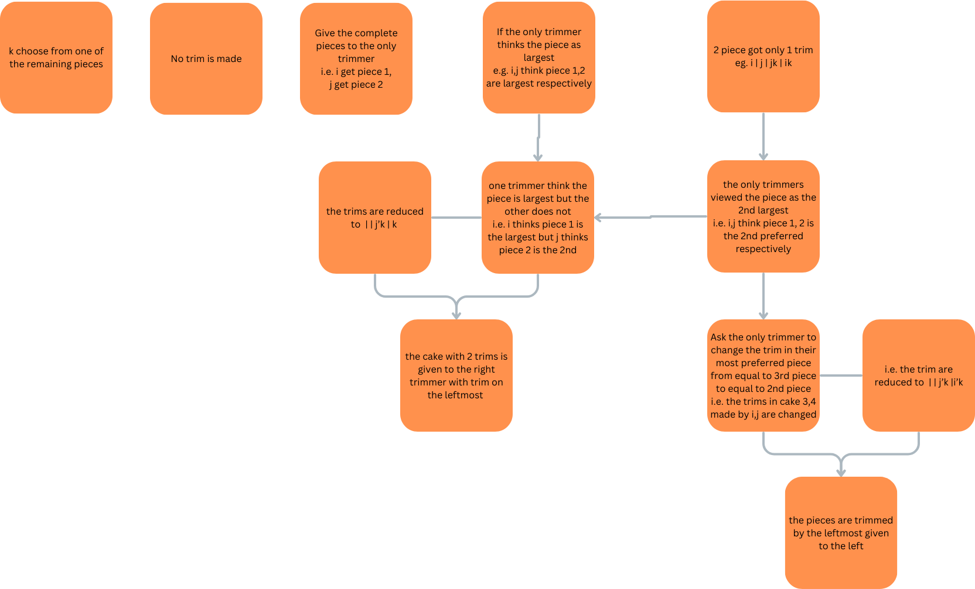
Algorithm - Core Protocol 4
If we are in case 4 (1,1,2,2 trims for 4 piece) i.e. i₁ | j₁ | j₂k₁ | i₂k₂ then
If one of the solo cutter (says i or j) view it as most preferred then
If both view it as most preferred then no trim and (i, j) receive the complete version the piece, k take the remaining,
Then (4) take the remaining
else (call this M2)
(only one of them view like this, says i)
j trim his most preferred to his
second most preferred piece (i | j’k | k)
for cake with 2 trim (cake 2),
rightmost trim player receive the trimmed
cake up to the leftmost trim
remaining complete give to the
remaining player, Then (4) take the last
End if

Slide 48
Algorithm - Core Protocol 4 (cont’)
(If we are in case 4 (1,1,2,2 trims for 4 piece) i.e. i₁ | j₁ | j₂k₁ | i₂k₂ )
else (one of solo cutter view cake with muti-trim as most preferred)
If only one solo cutter view it that way then excute M2
else (Both solo cutter view it that way)
he re-locate the trim so that it is equal to his 2nd most preferred piece instead, then this cake 3,4 is assigned to
rightmost trimmer with the trim at the
2nd rightmost trim
End if
End if

Slide 49
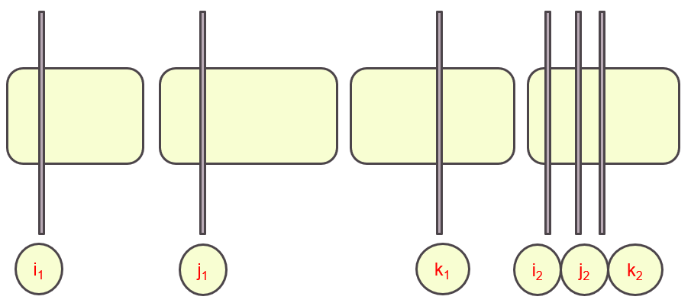
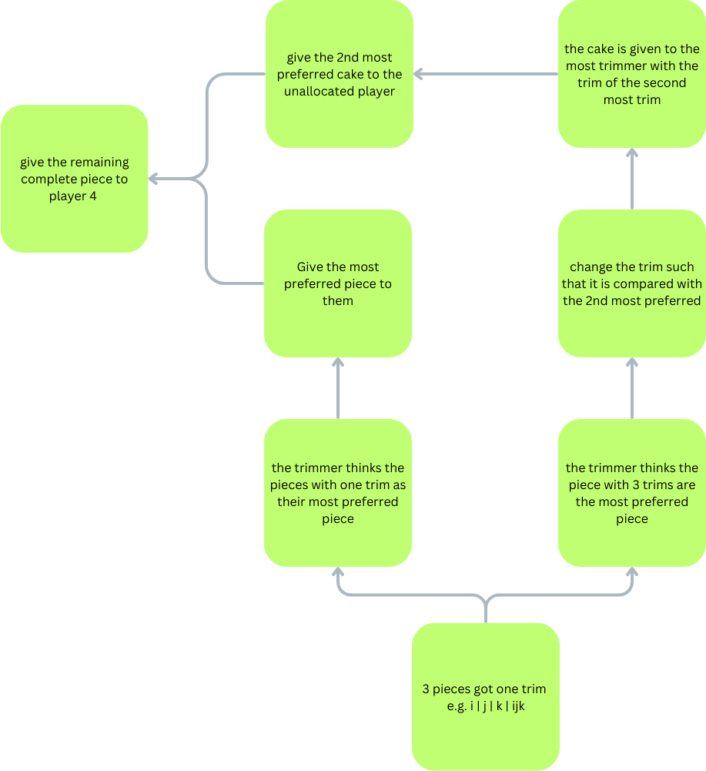
Algorithm - Core Protocol 5
If we are in case 5 (1,1,1,3 trims for 4 piece) i.e. i₁ | j₁ | k₁ | i₂ j₂k₂ then
If the solo cutter (says i or j or k) view it as most preferred then
no trim for his piece and receive the complete version the piece,
else (solo cutter view cake 4 as most preferred)
he re-locate the trim so that it is equal to his 2nd most
preferred piece instead, then this cake 4 is assigned to
rightmost trimmer with the trim at the middle trim
his 2nd most preferred cake give to the unlocated
End if
Then (4) take the remaining
End if
Return Envy-free allocation & possibly unallocated piece

Slide 50
3.3
Permutation Protocol

Slide 51
The Core Protocol iteration may have a result that the cutter keeps dominating the same player, Permutation Protocol aims to achieve Double Domination with higher efficiency (i.e. less iterations)
Input:
Remaining cake from the output of Core Protocol, say (4) is the cutter and (1) receive the significant piece
Output:
Allocation that each player gets a piece equal to the value he trimmed to in the Core Protocol and (2) or (3) receive the significant piece

Slide 52
illustration
2
3
1
4
2
3
1

Slide 53
illustration
2
3
1
4
2
3
1

Slide 54
Algorithm - Permutation Protocol 1
If (2) compete with some player and receive trimmed (he trimmed the most) then
If the second rightmost trim on (2)’s piece is (1) then permute (1) & (2)
2
3
1
4
1
2
2
1

Slide 55
Algorithm - Permutation Protocol 2
If (2) compete with some player and receive trimmed (he trimmed the most) then
Else if the second rightmost trim on (2)’s piece is (3) then
- cake (2) give to player (3)
- cake (1)’ (trimmed) give to player (2)
- cake (3) or (4) (complete) give to player (1)
- player (4) receive the remaining (complete piece)
2
3
1
4
3
2
2
1

Slide 56
Algorithm - Permutation Protocol 3
Else if (2) received a complete piece and he is not competing with some player then
If his piece have a trim mark by (1) (i.e. (2) hold (1)’s 2nd most preferred piece ) then permute (1) & (2)
2
3
1
4
1
3
1

Slide 57
Algorithm - Permutation Protocol 4
Else if (2) received a complete piece and he is not competing with some player then
If (4) have a trim mark by (1) (i.e. (4) hold (1)’s 2nd most preferred piece ) then permute in the following order
- cake (2) -> player (4)
- cake (4) -> player (1)
- cake (1) -> player (2)
2
3
1
4
3
1
1

Slide 58
Algorithm - Permutation Protocol 5
Else if (2) received a complete piece and he is not competing with some player then
If (3) is complete s.t. it have a trim mark by (1) (i.e. (4) hold (1)’s 2nd most preferred piece ) and (3) is indifferent between two piece among his top 3 pieces (guaranteed to happen after core protocol)
then permute in the following order
- cake (3) -> player (1)
- cake (1) -> player (2)
- player (3) choose between cake (2) and (4)
- (4) get the remaining complete piece
End if
2
3
1
4
1
1

Slide 59
Algorithm - Permutation Protocol 5
2
3
1
4
1
1

Slide 60
3.4
Overall Protocol

Slide 61
Overall Protocol setup – Lemma
Single-Domination Protocol
For n = 4, there exists a discrete and bounded protocol which returns an envy-free partial allocation in which one player dominates another player

Slide 62
Algorithm - Overall Protocol
While (
Some player i does not dominate two player; and
There exist some unallocated piece ) do
Run Core Protocol 4 times on the unallocated piece with i as the cutter [i dominate one player after two iteration by Single-Domination Protocol
lemma ]
If there are exist a player (say j) get the significant piece in each of the 4 iterations then
Identify which iteration that the non-cutter receive less bonus than the sum of the bonuses in the other iteration
Run Permutation Protocol on this iteration with i as cutter, j get the significant piece
end if
Run Core Protocol for the unallocated cake if there is any
End while

Slide 63
Algorithm (cont’) - Overall Protocol
If there is some unallocated cake then
Run Post Double Domination Protocol on the remain cake
End if
Return envy-free complete allocation

Slide 64
4
Conclusion

Slide 65
Founding
Lemma
- Double Domination Lemma
- Core Protocol Lemma
- Single Domination Lemma
- Permutation Lemma
Comment on Envy-freeness & Boundedness
Strategic-proof claim

Slide 66
Important Lemma - 1
Double Domination Lemma
Suppose we have a bound protocol which take (i) and an unallocated piece as input, and output a partial envy -free allocation s.t. i dominate 2 other players,
Then we can extend this to 4 players envy-free bounded protocol
(Demostrated in Post Double Domination Protocol)

Slide 67
Important Lemma - 2
Core Protocol Lemma
For n=4, there exist a discrete and bounded protocol which returns partial envy-free allocation in which one player cuts the cake into 4 equally preferred pieces and the cutter as well as at least one player gets one of those complete pieces
(Demostrated in Core Protocol)

Slide 68
Important Lemma - 3
Single-Domination Protocol Lemma
For n = 4, there exists a discrete and bounded protocol which returns an envy-free partial allocation in which one player dominates another player
(Served as a key building block for Overall Protocol, this help permutation protocol achieve domination)

Slide 69
Important Lemma - 4
Permutation Lemma
There exist a discrete and bounded protocol for 4 players that return a partial envy-free allocation in which one player dominates two other players
(Demostrated in Permutation Protocol)

Slide 70
Comment
How to achieve Envy-Freeness:
We run the core protocol for 5 iterations then run permutation protocol for each players so that he will have double domination.
Do it for 4 player then we run the Post Double Domination Protocol to return an envy-free complete allocation
How to achieve boundedness:
Core Protocol: Max. 10 cut
Post Double Domination Protocol: Max. 3
Max. number of cut: 10*5(iteration)*4(players)+3=203

Slide 71
Strategic-Proof
Claim:
For a partial allocation as a result of the core protocol in which players make trims, a re-allocation can be done in which some agent other than (1) gets the significant piece and each player gets a piece of value corresponding to his original trims but in which he may lose out on the additional bonus due to the 2nd rightmost trims

Slide 72
Sources
This material is mainly based on the result from the paper
[A Discrete and Bounded Envy-free Cake Cutting Prtocol for Four Agents] by Haris Aziz, Simon Mackenzie (2016)
Citation:
[1]: F. E. Su. Rental harmony: Sperner’s lemma in fair division. American Mathematical Monthly, 10:930–942., 1999.

